Slide 1
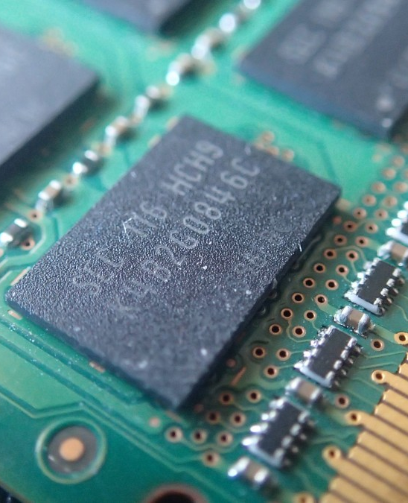
Introduction to Virtual Memory
Presented By: Bikal Thapa

Slide 2
What is Virtual Memory?
Virtual memory is a memory management technique that allows an operating system to use hardware and disk storage as if it were a larger RAM.
It enhances system efficiency and multitasking.

Slide 3

Key Features
PAGING
Paging divides memory into fixed-size blocks called pages, simplifying allocation and management.
SEGMENTATION
Segmentation involves dividing memory into variable-sized segments based on logical divisions, improving accessibility.

Slide 4
Drawbacks of Virtual Memory
Performance Overhead
Disk Space Consumption
Slower Access Time
Swapping takes time and the system will become slower and takes more time in switching between applications.
Virtual Memory consumes the storage of secondary memory and the secondary memory may be insufficient.
Since the secondary storage have high access time than primary the program takes more time to load

Slide 5
Benefits of Virtual Memory
EFFICIENT MEMORY USE
MULTITASKING CAPABILITIES
ISOLATION OF PROCESSES
Allows the use of disk space for virtual addresses, enabling more processes to run than physical memory alone permits.
Facilitates simultaneous execution of multiple applications, improving responsiveness and user experience.
Each process operates in its own memory space, enhancing security and stability by preventing direct access to another process's memory.

Slide 6
Thank You

